Slide 1
Supervised
Machine Learning
Eng- Mohamed Khaled Idris
Eng- Mayar Swilam

Slide 2
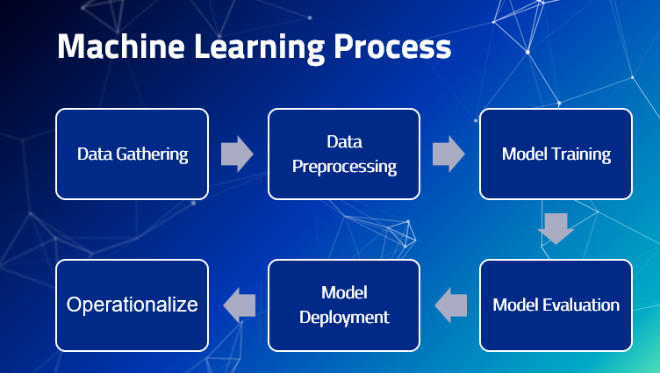

Slide 3

Supervised Machine Learning (Regression)

Slide 4
What is Regression ?
Regression is a statistical technique used in data analysis to model the relationship between a dependent variable (also called the outcome or target variable) and one or more independent variables (also known as predictor variables or features).
The main goal of regression analysis is to understand and quantify how changes in the independent variables are associated with changes in the dependent variable.
In simpler terms, regression helps us predict or estimate a continuous numerical outcome based on one or more input variables.

Slide 5
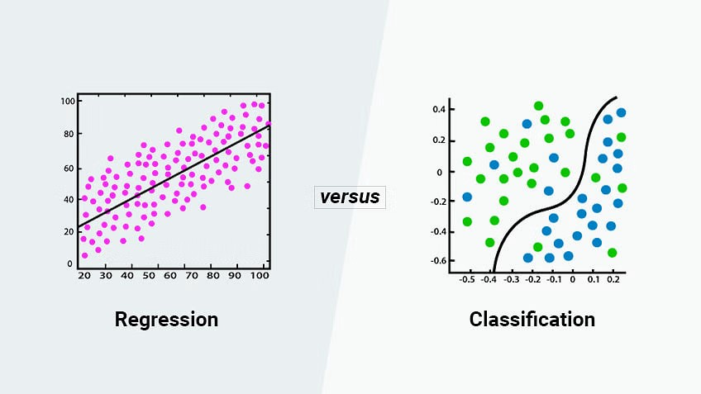

Slide 6
Example
X | 1 | 2 | 3 | 4 | 5 | 6
y | 10 | 15 | 20 | 25 | ?? | ??

Slide 7
Suggest a way to solve for x = 5, x = 6

Slide 8
One of the ideas
y = mx + b
Try to fit the previous points on a line
1
Use the slope equation and find the slope
m = y2 – y1 / x2 – x1
2
Find the y-intercept e.g. b of the equation
3
Substitute x values on the equation to find the y values
4

Slide 9
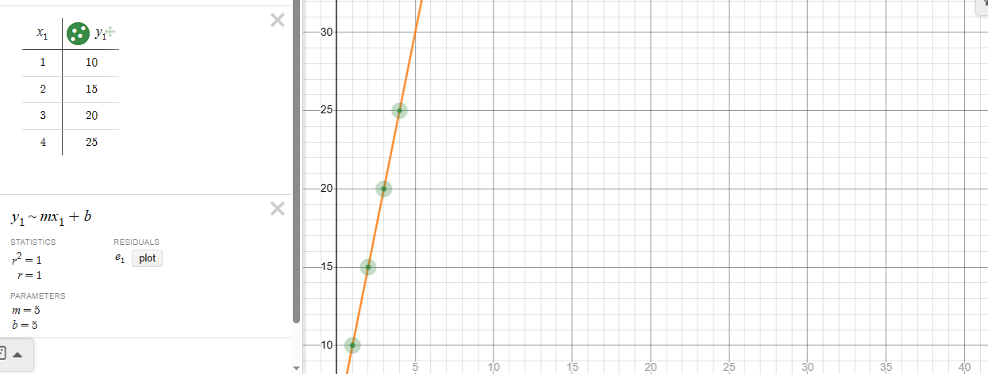

Slide 10
y = 5x + 5
X | 1 | 2 | 3 | 4 | 5 | 6
y | 10 | 15 | 20 | 25 | 30 | ??

Slide 11
y = 5x + 5
X | 1 | 2 | 3 | 4 | 5 | 6
y | 10 | 15 | 20 | 25 | 30 | 35

Slide 12
What if
X | 1 | 2 | 3 | 4 | 5 | 6
y | 1 | 9 | 11 | 31 | ?? | ??

Slide 13
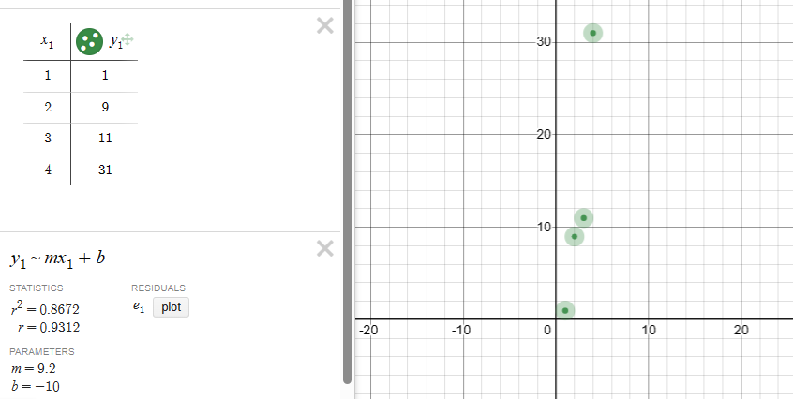
The entire problem

Slide 14
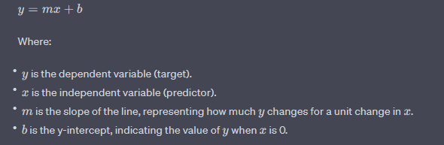
The Idea
In linear regression, the goal is to FIND THE BEST-FITTING STRAIGHT LINE (LINEAR EQUATION) that represents the relationship between the predictor(s) and the target variable.

Slide 15
What is regression used for ?
Prediction: Given new input values, regression models can be used to predict the likely value of the dependent variable.
Inference: Regression analysis can help us understand the relationship between variables and provide insights into how changes in the predictors affect the outcome.
Control: In experimental settings, regression can be used to determine how changes in the independent variables impact the dependent variable, allowing for better control over the experimental conditions.

Slide 16
Linear Regression

Slide 17
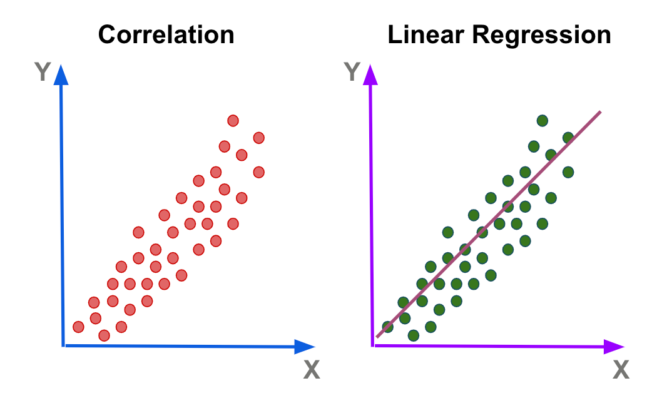
Linear Regression
Linear regression is a statistical method used to model the relationship between a dependent variable (target) and one or more independent variables (predictors) by assuming a linear relationship between them.
It's one of the simplest and most commonly used regression techniques.

Slide 18
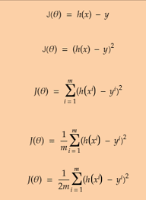
Theta0= 5 , theta 1 = 2 , h(x) = 5 + 2x
J = 1/ 14 (0+1+4+4+4+25+9)= 47/14=3.3
x | y | h(x) | h(x) - y | (h(x) – y)^2
1 | 7 | 7 | 0 | 0
2 | 8 | 9 | 1 | 1
2 | 7 | 9 | 2 | 4
3 | 9 | 11 | 2 | 4
4 | 11 | 13 | 2 | 4
5 | 10 | 15 | 5 | 25
5 | 12 | 15 | 3 | 9

Slide 19
Methods to find thE best fitting-line
Ordinary Least Squares (OLS)
Gradient Descent (GD)
Ridge
Lasso
Elastic Net
Stochastic Gradient Decent (SGD)

Slide 20
Gradient Descent
Gradient descent is an iterative optimization algorithm used to find the minimum of a function, particularly in machine learning and numerical optimization.
It's widely used for updating the parameters of a model in order to minimize a COST FUNCTION or objective function.
The "gradient" in gradient descent refers to the gradient vector of PARTIAL DERIVATIVES of the function with respect to its parameters.

Slide 21
The basic Idea of Gradient Descent
The fundamental idea behind gradient descent is to ITERATIVELY adjust the parameters of a model in the direction of the steepest descent (negative gradient) of the cost function.
By repeatedly taking steps in the direction that reduces the value of the cost function, the algorithm eventually converges to a local or global minimum.

Slide 22
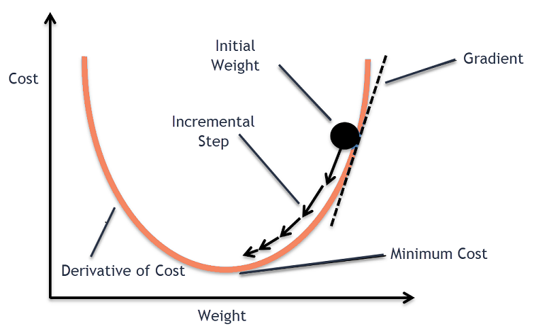
(Error)

Slide 23
Steps of the gradient descent
New Parameter=Old Parameter−Learning Rate × Gradient
Initialization: Start with initial values for the parameters of the model.
Compute the Gradient: Calculate the gradient of the cost function with respect to EACH PARAMETER.
Update the Parameters: Adjust the parameters by moving in the opposite direction of the gradient.
Repeat: Steps 2 and 3 are repeated iteratively until a stopping criterion is met.

Slide 24
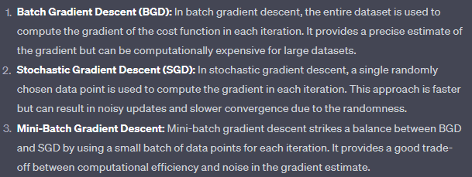
Types of Gradient Descent

Slide 25
Putting all together
We are using (Least Square) and must be added to COST FUNCTION
Our required parameters is M slope and b y-intercept
We will use Batch Gradient Descent in order to modify the M and b parameters as to minimize the cost function (Error rate)
This process will be iterative until the stopping criteria is met
The line generated by using best m and b values are BEST FITTING-LINE

Slide 26
Cost functions
In linear regression, the cost function (also known as the loss function or objective function) quantifies how well the model's predictions match the actual observed values.
The goal of linear regression is to find the parameters (coefficients) of the linear equation THAT MINIMIZE THIS COST FUNCTION.

Slide 27
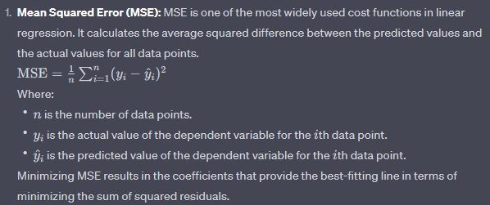
Mean Squared Error (MSE)
Least Squares
This one will be used as cost function

Slide 28
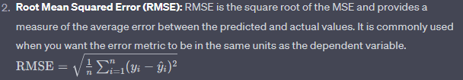
Root Mean Squared Error (RMSE)

Slide 29

Mean absolute Error (MAE)

Slide 30
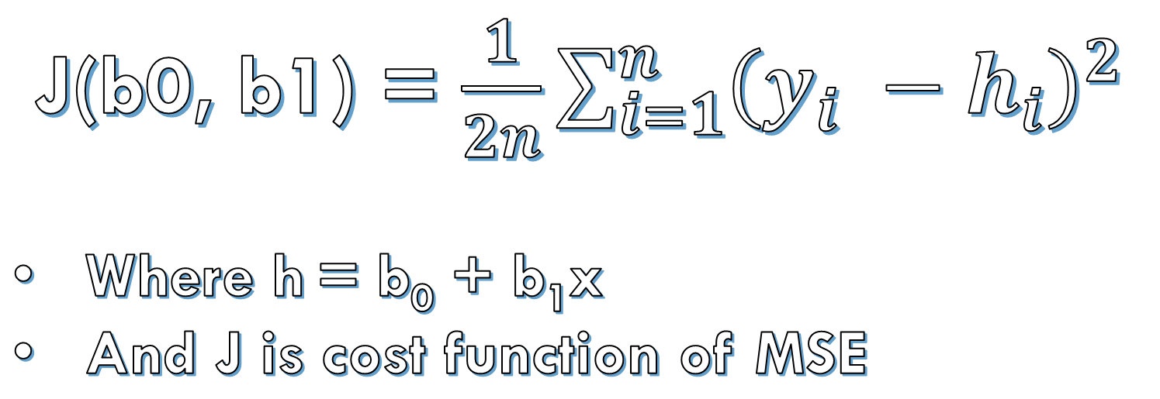
The full Equation
J(b0, b1) = $\frac{1}{2n}\sum_{i=1}^{n}{{\left(y_{i} −h_{i}\right)}^{2}}$
Where h = b₀ + b₁x
And J is cost function of MSE

Slide 31
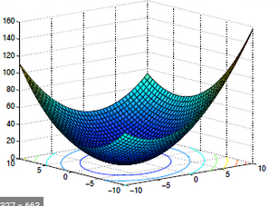
The relation between j, b0 and b1
3D

Slide 32
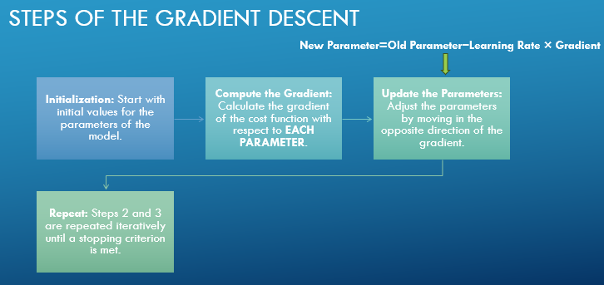
To Remember

Slide 33
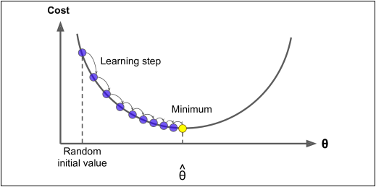
The slope is NEGATIVE

Slide 34
The slope is POSITIVE

Slide 35
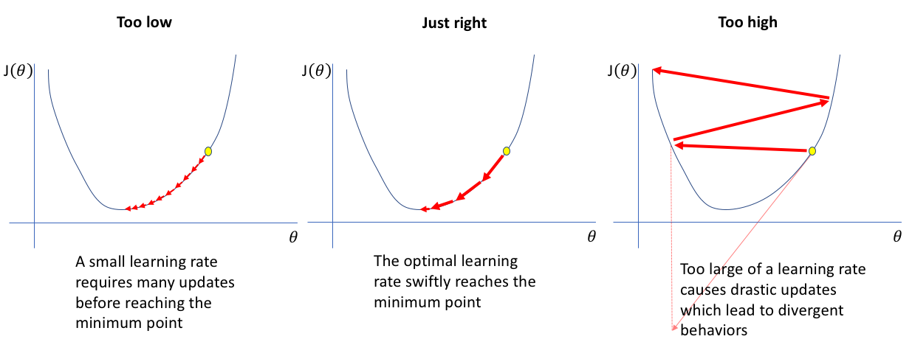
Learning Rate (Cont.)

Slide 36
Area x1 | Rooms x2 | Age x3 | Sea x4 | Price
120 | 3 | 4 | 1 | 150
60 | 1 | 15 | 0 | 50
100 | 4 | 1 | 1 | 230
Theta
y = Θ1 X1 + Θ2 X2 + Θ 3 X3 + Θ 4 X4
Y= 53.6 X1+8547 X2+653.3 X3 +452 X4
1. Building Math Equation
2. Randomised Thetas: between 0 and 1
a. Calculating Predicted Value
Phase 1:
y=0.56 X10.496 X2+0.87450 X3 +0.02036 X4
y=0.56 120+0.4963-0.874504 +0.020361-170
Theta
y = Θ1 X1 + Θ2 X2 + Θ 3 X3 + Θ 4 X4

Slide 37

Questions

Slide 38
Thank you

